Slide 1

Muddy River
Commodities and Real Option Deal Memo
Oct 10, 2019
Wright Consultancy LLC
485 Madison Ave.
Manhattan, NY 10022
p: +1.212.349.2310
WrightConsultancy

Slide 2
Agenda
05
04
03
02
01
Client Objective
Solution
Model Construction
Valuation Strategy
Sensitivity Analysis

Slide 3

01
Client Objective

Slide 4


Client Objective
Client
Counterparty
90% net operating earnings from the Muddy
River Power Plant from 2016-2018
$24m at Dec. 2015
EnerGen Corp.
Bobba Fett
Ultimate Goal Evaluate whether $24M is enough for the real option
1 Client Objective
2 Solution
3 Model Construction
4 Valuation Strategy
5 Sensitivity Analysis

Slide 5
Client Objective
Muddy River Power Plant
[ Two Constraints ]
- Generation Capacity: 1000 megawatts
- Heat rate: 12 mmBTU/Mwh
- Non-fuel variable costs: $5 per Mwh megawatts
- Status now: Off
End Week Lag
01
02
Start Week Cost
($3/Mwh)
1 Client Objective
2 Solution
3 Model Construction
4 Valuation Strategy
5 Sensitivity Analysis

Slide 6
02
Solution

Slide 7
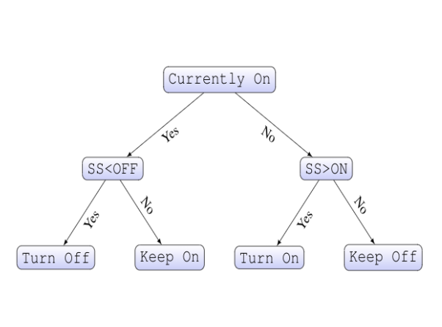
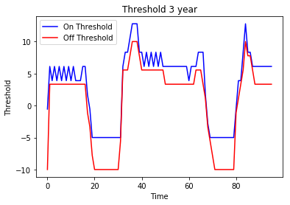
Valuation Solution
Operating Policy
SS: spark spread (Power– 12 * Gas)
1 Client Objective
2 Solution
3 Model Construction
4 Valuation Strategy
5 Sensitivity Analysis

Slide 8
Valuation Solution
Operating Policy
Valuation Result
90% of the net operating policy:
$93.98 M
1 Client Objective
2 Solution
3 Model Construction
4 Valuation Strategy
5 Sensitivity Analysis

Slide 9
03
Model Construction

Slide 10
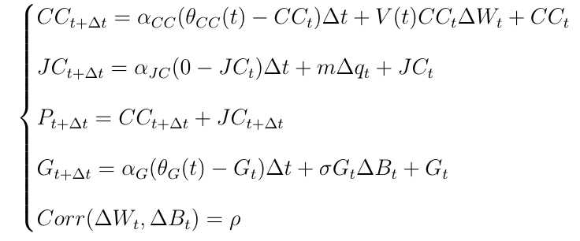
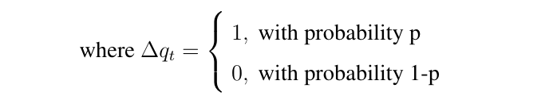
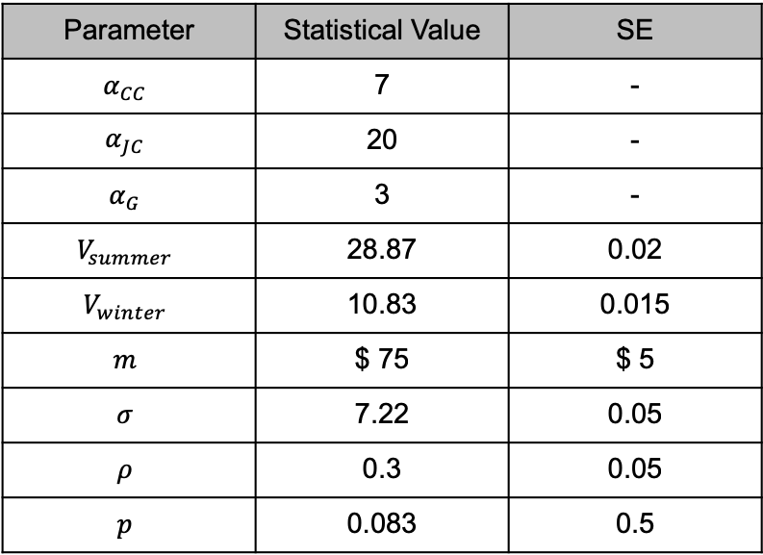
Model Calibration
Power and Gas Process
Parameter | Statistical Value | SE
$$α_{CC}$$ | 7 | -
$$α_{JC}$$ | 20 | -
$$α_{G}$$ | 3 | -
$$V_{summer}$$ | 28.87 | 0.02
$$V_{winter}$$ | 10.83 | 0.015
$$m$$ | $ 75 | $ 5
$$σ$$ | 7.22 | 0.05
$$ρ$$ | 0.3 | 0.05
$$p$$ | 0.083 | 0.5
* The values of $V_{summer}$/ $V_{winter}$/ $σ$/ $prob(Δq_{t}=1)$ are un-annualized
1 Client Objective
2 Solution
3 Model Construction
4 Valuation Strategy
5 Sensitivity Analysis

Slide 11
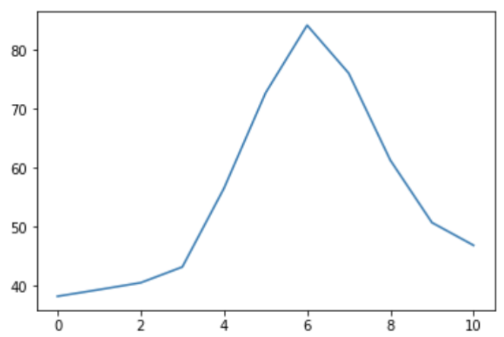
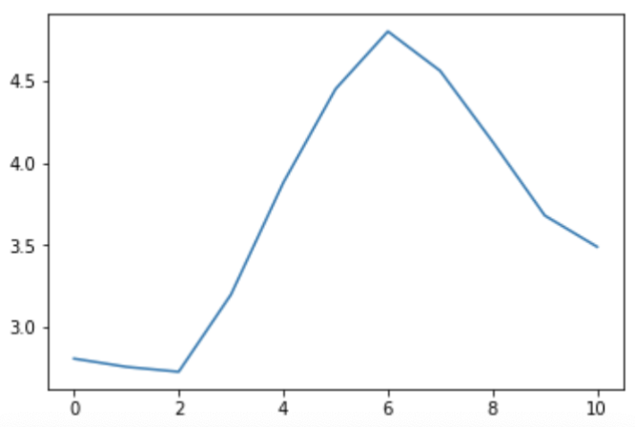




Model Calibration
Given Historical Forward Price Data
$θ\left(t\right)$ Calibration
Power
$$θ\left(12\right)$$
……
$$θ\left(2\right)$$
$$θ\left(1\right)$$
Gas
BootStrap
1 Client Objective
2 Solution
3 Model Construction
4 Valuation Strategy
5 Sensitivity Analysis

Slide 12
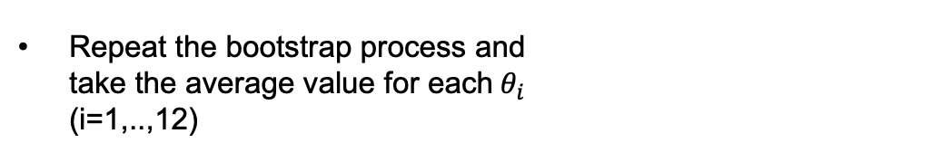

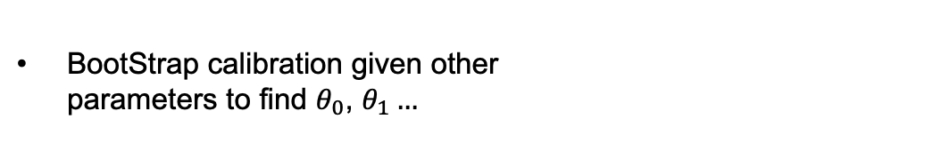
Model Calibration
$θ\left(t\right)$ Calibration
Given Historical Forward Price Data
$θ\left(t\right)$: Step-wise function (12 stages)
BootStrap calibration given other
parameters to find $θ_{0}$, $θ_{1}…$
$$θ\left(12\right)$$
……
$$θ\left(2\right)$$
Repeat the bootstrap process and
take the average value for each${ θ}_{i }$
(i=1,..,12)
$$θ\left(1\right)$$
BootStrap
1 Client Objective
2 Solution
3 Model Construction
4 Valuation Strategy
5 Sensitivity Analysis

Slide 13
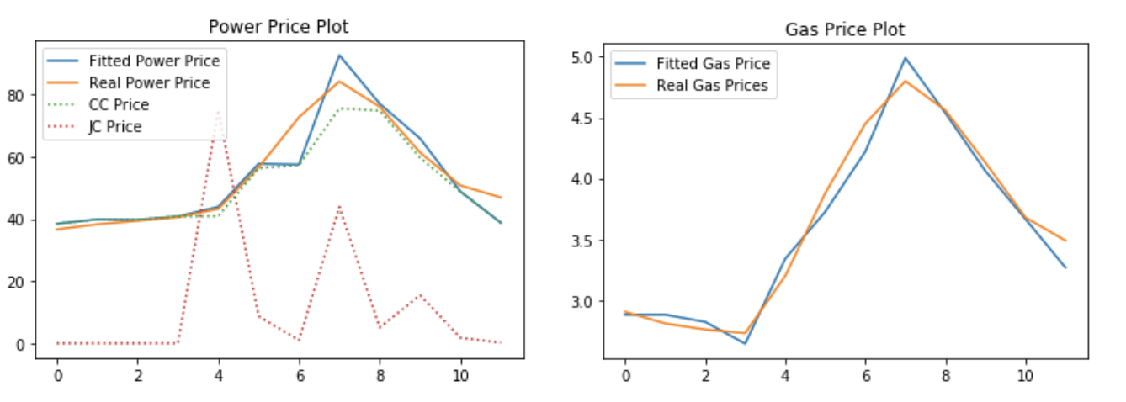
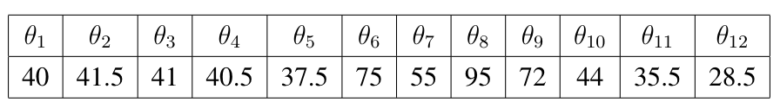
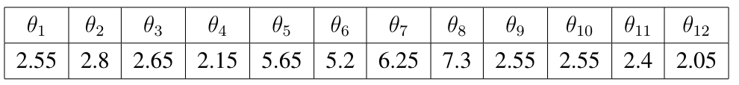


Model Calibration
$θ\left(t\right)$ Calibration
$θ\left(t\right)$ for Power
$θ\left(t\right)$ for Gas
1 Client Objective
2 Solution
3 Model Construction
4 Valuation Strategy
5 Sensitivity Analysis

Slide 14
04
Valuation Strategy

Slide 15


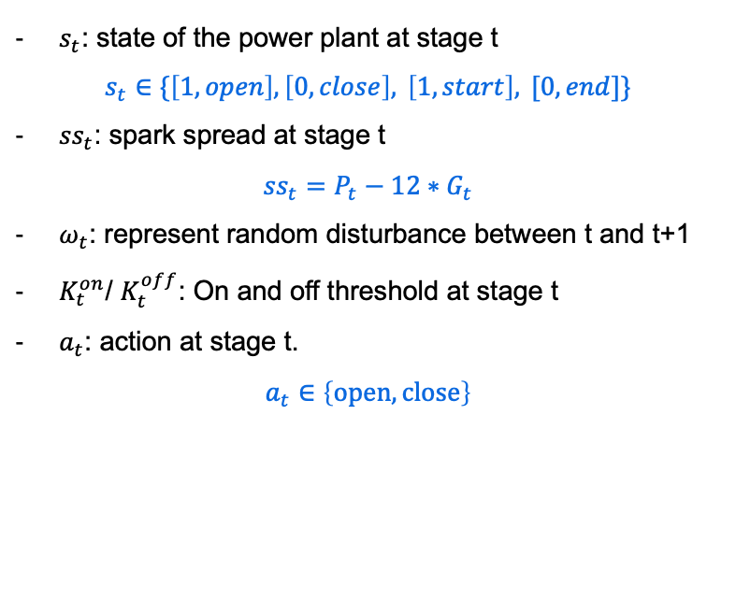









Valuation Strategy
Operating Policy based on Dynamic Threshold
Some Notation
$θ\left(t\right)$ for Power
$$K_{t}^{on}$$
$$K_{t}^{off}$$
$$a_{t}$$
$$K_{T−1}^{on}$$
$$K_{T−1}^{off}$$
$$a_{T−1}$$
$s_{t}$: state of the power plant at stage t
$$s_{t}∈\{\left[1, open\right], \left[0, close\right], \left[1,start\right], [0,end]\}$$
${ss}_{t}$: spark spread at stage t
$${ss}_{t}=P_{t}−12∗G_{t}$$
$ω_{t}$: represent random disturbance between t and t+1
$K_{t}^{on}$/ $K_{t}^{off}$: On and off threshold at stage t
$a_{t}$: action at stage t.
$$a_{t}∈\left\{open, close\right\}$$
$$K_{0}^{on}$$
$$K_{0}^{off}$$
$$a_{0}$$
$$K_{1}^{on}$$
$$K_{1}^{off}$$
$$a_{1}$$
Action
…
…
…
…
0
1
t-1
t
t+1
T-1
T
$$s_{0}$$
$${ss}_{0}$$
$$ω_{0}$$
$$s_{1}$$
$${ss}_{1}$$
$$ω_{1}$$
$$s_{t}$$
$${ss}_{t}$$
$$ω_{t}$$
$$s_{t+1}$$
$${ss}_{t+1}$$
$$ω_{t+1}$$
$$s_{T−1}$$
$${ss}_{T−1}$$
$$ω_{T−1}$$
$$s_{T}$$
$${ss}_{T}$$
$$ω_{T}$$
State
…
1 Client Objective
2 Solution
3 Model Construction
4 Valuation Strategy
5 Sensitivity Analysis

Slide 16
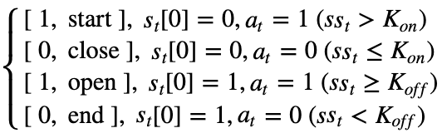










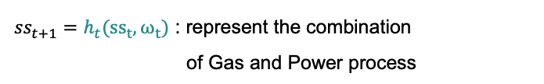


Valuation Strategy
Operating Policy based on Dynamic Threshold
System Dynamics
$θ\left(t\right)$ Calibration
At stage t, ($s_{t}$, ${ss}_{t}$) known
$θ\left(t\right)$ for Power
$$K_{t}^{on}$$
$$K_{t}^{off}$$
$$a_{t}$$
$$K_{T−1}^{on}$$
$$K_{T−1}^{off}$$
$$a_{T−1}$$
$(K_{t}^{on}$, $K_{t}^{off}$)
$$K_{0}^{on}$$
$$K_{0}^{off}$$
$$a_{0}$$
$$K_{1}^{on}$$
$$K_{1}^{off}$$
$$a_{1}$$
Action
…
…
$${ss}_{t}$$
+ $s_{t}[0]$ & ${ss}_{t}$
+ $ω_{t}$
$$h_{t}(·)$$
$$a_{t}$$
$${ss}_{t+1}$$
…
…
0
1
t-1
t
t+1
T-1
T
$$f_{t}(·)$$
+ $s_{t}[0]$
$$s_{0}$$
$${ss}_{0}$$
$$ω_{0}$$
$$s_{1}$$
$${ss}_{1}$$
$$ω_{1}$$
$$s_{t}$$
$${ss}_{t}$$
$$ω_{t}$$
$$s_{t+1}$$
$${ss}_{t+1}$$
$$ω_{t+1}$$
$$s_{T−1}$$
$${ss}_{T−1}$$
$$ω_{T−1}$$
$$s_{T}$$
$${ss}_{T}$$
$$ω_{T}$$
$$s_{t+1}$$
State
…
$s_{t+1}=f_{t}(a_{t}, s_{t}[0])$ =
Law of Motion
${ss}_{t+1}=h_{t}({ss}_{t}, ω_{t})$ : represent the combination
of Gas and Power process
1 Client Objective
2 Solution
3 Model Construction
4 Valuation Strategy
5 Sensitivity Analysis

Slide 17
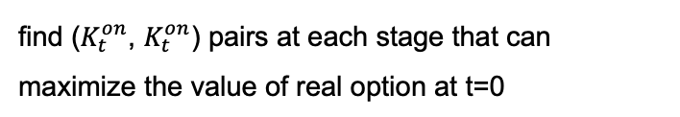
Valuation Strategy
Operating Policy based on Dynamic Threshold
$θ\left(t\right)$ Calibration
Goal
$$K_{T−1}^{on}$$
$$K_{T−1}^{off}$$
$$a_{T−1}$$
find ($K_{t}^{on}$, $K_{t}^{on}$) pairs at each stage that can
maximize the value of real option at t=0
$θ\left(t\right)$ for Power
$$K_{t}^{on}$$
$$K_{t}^{off}$$
$$a_{t}$$
$$K_{0}^{on}$$
$$K_{0}^{off}$$
$$a_{0}$$
$$K_{1}^{on}$$
$$K_{1}^{off}$$
$$a_{1}$$
Action
…
…
…
…
0
1
t-1
t
t+1
T-1
T
$$s_{0}$$
$${ss}_{0}$$
$$ω_{0}$$
$$s_{1}$$
$${ss}_{1}$$
$$ω_{1}$$
$$s_{t}$$
$${ss}_{t}$$
$$ω_{t}$$
$$s_{t+1}$$
$${ss}_{t+1}$$
$$ω_{t+1}$$
$$s_{T−1}$$
$${ss}_{T−1}$$
$$ω_{T−1}$$
$$s_{T}$$
$${ss}_{T}$$
$$ω_{T}$$
State
…
Multi-stage Stochastic Optimization
1 Client Objective
2 Solution
3 Model Construction
4 Valuation Strategy
5 Sensitivity Analysis

Slide 18
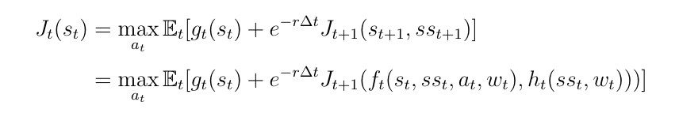
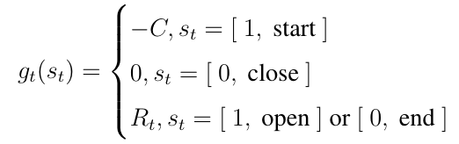
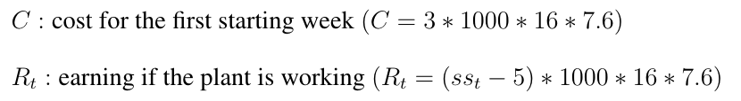


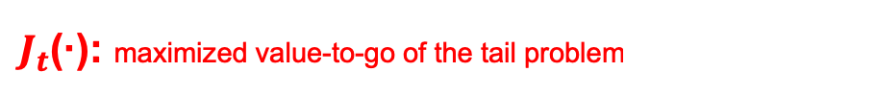


Valuation Strategy
Operating Policy based on Dynamic Threshold
Multi-stage Stochastic Optimization
$θ\left(t\right)$ Calibration
Bellman Equation
$$K_{T−1}^{on}$$
$$K_{T−1}^{off}$$
$$a_{T−1}$$
Idea: backward Induction, break down the multi-stage
problem into multiple two-stage problems
$θ\left(t\right)$ for Power
$$K_{t}^{on}$$
$$K_{t}^{off}$$
$$a_{t}$$
$$K_{0}^{on}$$
$$K_{0}^{off}$$
$$a_{0}$$
$$K_{1}^{on}$$
$$K_{1}^{off}$$
$$a_{1}$$
Action
…
…
…
…
0
1
t-1
t
t+1
T-1
T
$$s_{0}$$
$${ss}_{0}$$
$$ω_{0}$$
$$s_{1}$$
$${ss}_{1}$$
$$ω_{1}$$
$$s_{t}$$
$${ss}_{t}$$
$$ω_{t}$$
$$s_{t+1}$$
$${ss}_{t+1}$$
$$ω_{t+1}$$
$$s_{T−1}$$
$${ss}_{T−1}$$
$$ω_{T−1}$$
$$s_{T}$$
$${ss}_{T}$$
$$ω_{T}$$
State
…
$J_{t}$(·): maximized value-to-go of the tail problem
1 Client Objective
2 Solution
3 Model Construction
4 Valuation Strategy
5 Sensitivity Analysis

Slide 19
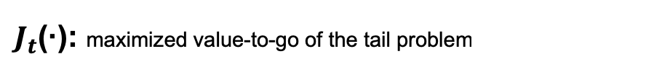
Valuation Strategy
Operating Policy based on Dynamic Threshold
Multi-stage Stochastic Optimization
$θ\left(t\right)$ Calibration
Bellman Equation
$$K_{T−1}^{on}$$
$$K_{T−1}^{off}$$
$$a_{T−1}$$
Idea: backward Induction, break down the multi-stage
problem into multiple two-stage problems
$θ\left(t\right)$ for Power
$$K_{t}^{on}$$
$$K_{t}^{off}$$
$$a_{t}$$
$$K_{0}^{on}$$
$$K_{0}^{off}$$
$$a_{0}$$
$$K_{1}^{on}$$
$$K_{1}^{off}$$
$$a_{1}$$
Action
…
…
…
…
0
1
t-1
t
t+1
T-1
T
$$s_{0}$$
$${ss}_{0}$$
$$ω_{0}$$
$$s_{1}$$
$${ss}_{1}$$
$$ω_{1}$$
$$s_{t}$$
$${ss}_{t}$$
$$ω_{t}$$
$$s_{t+1}$$
$${ss}_{t+1}$$
$$ω_{t+1}$$
$$s_{T−1}$$
$${ss}_{T−1}$$
$$ω_{T−1}$$
$$s_{T}$$
$${ss}_{T}$$
$$ω_{T}$$
State
…
Longstaff and Schwartz
$J_{t}$(·): maximized value-to-go of the tail problem
1 Client Objective
2 Solution
3 Model Construction
4 Valuation Strategy
5 Sensitivity Analysis

Slide 20
Valuation Strategy
Operating Policy based on Dynamic Threshold
$θ\left(t\right)$ Calibration
Multi-stage Stochastic Optimization
Longstaff and Schwartz
Idea:
(1) linear regression over basis functions to
approximate Expectation
(2) estimate the expectation conditional on
the current state (eg. only apply regression on the
ITM paths for American Option)
1 Client Objective
2 Solution
3 Model Construction
4 Valuation Strategy
5 Sensitivity Analysis

Slide 21
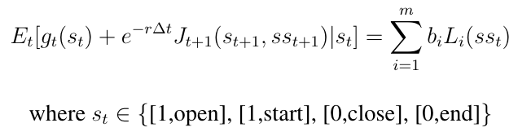
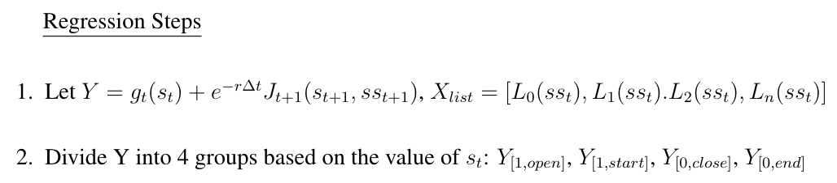
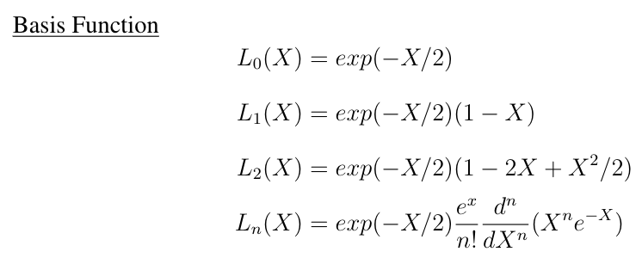
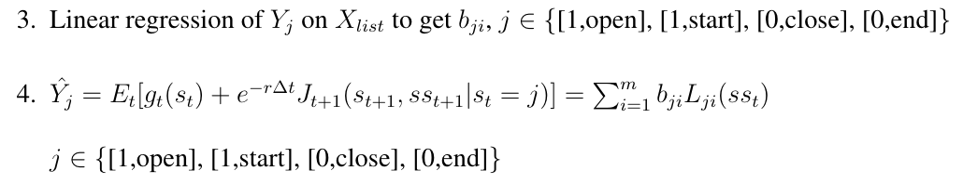
Valuation Strategy
Operating Policy based on Dynamic Threshold
$θ\left(t\right)$ Calibration
Multi-stage Stochastic Optimization
Longstaff and Schwartz
1 Client Objective
2 Solution
3 Model Construction
4 Valuation Strategy
5 Sensitivity Analysis

Slide 22
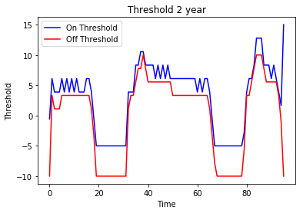
Valuation Strategy
Operating Policy based on Dynamic Threshold
$θ\left(t\right)$ Calibration
Optimization Result
Short-term Strategy (T=2y)
Long-term Strategy (T=3y)
2 year value: $93.7M ($104.11M * 0.9)
2 year value: 93.98 ($104.42M * 0.9)
图
1 Client Objective
2 Solution
3 Model Construction
4 Valuation Strategy
5 Sensitivity Analysis

Slide 23
05
Sensitivity Analysis

Slide 24
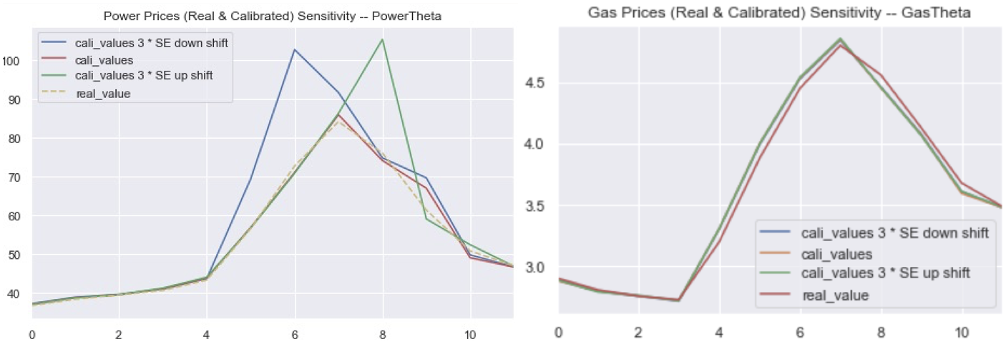


Model Sensitivity
comparison with original forward curves
$θ\left(t\right)$ Calibration
Run theta calibration for 100 times and calculate SE for each $θ_{i}$ (i=1,…12)
Add +3 SE, -3 SE to theta, and simulate again
Compare power and gas prices with original prices
Sensitivity Analysis on $θ(t)$
1 Client Objective
2 Solution
3 Model Construction
4 Valuation Strategy
5 Sensitivity Analysis

Slide 25
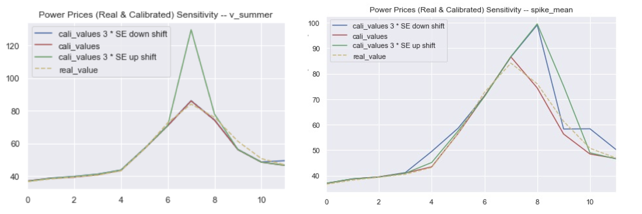
Model Sensitivity
comparison with original forward curves
$θ\left(t\right)$ Calibration
Sensitivity Analysis on other parameters
1 Client Objective
2 Solution
3 Model Construction
4 Valuation Strategy
5 Sensitivity Analysis

Slide 26
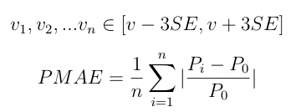
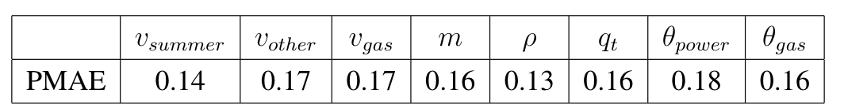
Valuation Sensitivity
Influence of different parameters changes on the final valuation for earnings
Percentage Mean Absolute Deviation
1 Client Objective
2 Solution
3 Model Construction
4 Valuation Strategy
5 Sensitivity Analysis

Slide 27
Summary
Valuation Result
(long-term strategy)
Bootstrap Calibration
Dynamic Threshold Operating Policy
90% x $104.42m = $93.98m >> $24m
Conclusion
Model and Valuation Sensitivity Analysis
$24M is far from enough for the real option.

Slide 28


